Slide 1
JAVA
Java is a most popular programming language

Slide 2
Introduction:
popular programing language.
Class based, high level and purely object oriented programing language.
It support primitive and non primitive data types.
platform independent.

Slide 3
Uses:
Mobile , Desktop, Web applications
Games
Database connections
Robotics
Smartcard
Embedded system
Banking Applications

Slide 4
History of JAVA:
Java was introduced by James Gosling, who is known as father of Java, in 1995.
It is developed by Sun Microsystems ( now subsidiary of Oracle ).
Java team members called Green Team.
Initially java was developed for electronic devices such as set-top boxes, televisions, etc.
Later it was best suited for internet programming. So java technology was incorporated by Netscape.
Currently, java is used in internet programming, mobile applications, web applications, games, etc.
Many java versions have been released till now. The current stable release of java is SE 10.

Slide 5
JAVA terminology:
JDK:
Stands for Java Development kit.
Provide required functionality to develop, compile and execute
java application or program.
It download from oracle website.
On 23 Jan 1996, java’s JDK 1.0 version was officially released by
sun Microsystems. The latest version of Java’s JDK 17.0(Sep 2021).
JRE:
Stands for Java Runtime Environment.
JDK includes JRE.
It provide the class libraries and other resources to run the program.
For compiling and running the java program, computer needs JRE.

Slide 6
JVM:
Stands for Java Virtual Machine.
It act as interpreter( load, verify, execute).
Garbage collection process is handled in JVM.
Purpose:
Java program to run in any environment.
Maintain and optimize program memory.
JIT:
Just In Time.
It improves the performance of JVM.

Slide 7
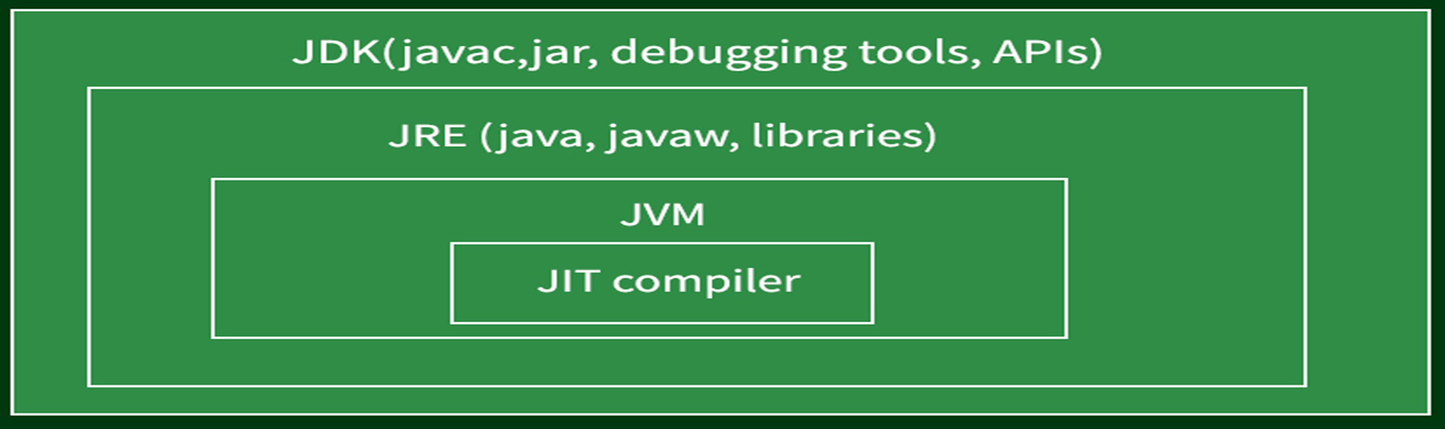
Structure of JDK:

Slide 8
Java programmer done by writing a program:
Compilation is done by javac compile.
Java compiler include in java development kit(JDK)
It takes Java program as input and generates bytecode as output.
JVM execute the bytecode produce by the compiler
Every OS has different JVM but the output produces after the execution of byte code in all the OS. So the java is known as platform independent language.

Slide 9
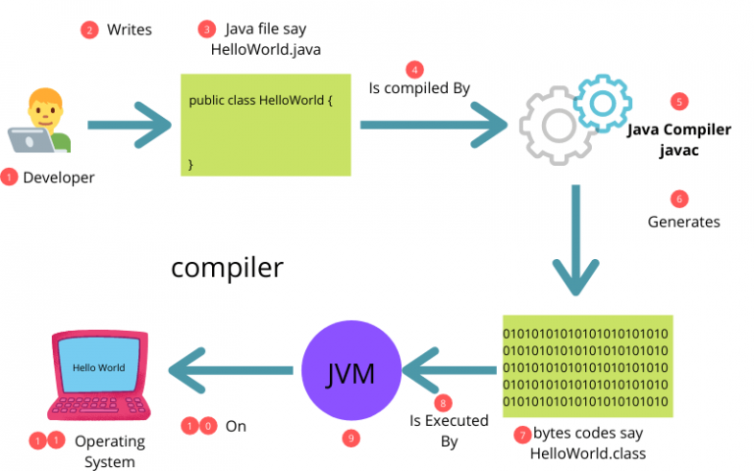
Java execution process:

Slide 10
Features of Java:
Simple:
Syntax is similar to like C++.
Pointers and operator overloading is not avail in java because avoid complexity.
Object oriented:
In Java everything is written in terms of classes and objects.
No coding outside of the class definition
Platform independent:
Write once and run anywhere(WORA).
Class files can run in any OS.

Slide 11
Secured:
No explicit pointer
Java Programs run inside a virtual machine sandbox
Class loader: It load Java classes into the JVM.
Bytecode Verifier: It verify the code.
Security Manager: It decide who all to read and write.
Re-usability of code:
Java provides the code reusability With the Help of Inheritance.
Portable:
It is easy to be carried or removed.

Slide 12
Robust:
Strong memory management
Garbage collection
Ability to continue if any connection is disable
Exception handling is possible
Architectural neutral:
Java code is translated into byte code after compilation which is independent of any computer architecture, it needs only JVM (Java Virtual Machine) to execute.
Distributed:
Concept of RMI and EJB to create distributed applications in java.
Access files by calling the methods from any machine on the internet.
EX: convert c++ to java use native methods.

Slide 13
Dynamic:
Dynamic memory allocation and loading
Update and changes are avail.
Compiled and interpreted:
Java programs are compiled to generate bytecode files.
JVM interprets the bytecode files during execution.
JVM uses JIT compiler.
Multithreading:
Thread is a piece of code can be executed independently.
Multiple threads run simultaneously called Multithreading.
Eg:
Google Docs
Where, while typing text, the spell check and autocorrect tasks are running.

Slide 14
Java Naming Convention:
To make your code easier to read for yourself and other programmer.
Readability of Java program is very important.
Java follows camel-case syntax for naming the class, interface, method, and variable.
If the name is combined with two words, the second word will start with uppercase letter always such as firstName, secondName

Slide 15
Class:
A collection of objects that exhibits the same state and behavior
will come under the same group called class.
It is a user defined datatype.
It is a template used to create objects.
It define datatmembers and methods.
It should start with the uppercase letter.
It should be a noun such as Color, Button, System, Thread, etc.
Syntax:
public class ClassName
{
//class body
}

Slide 16
Interface:
Used to group related methods with empty bodies.
Specifies the behavior of a class by providing an abstract type.
Its keyword “ interface”.
It should start with the uppercase letter.
Syntax:
interface InterfaceName
{
Public void methodName();
}

Slide 17
Method:
Methods are functions that perform actions.
It should start with lowercase letter.
It should be a verb such as main(), print(), println().
If the name contains multiple words, start it with a lowercase letter followed by an uppercase letter such as actionPerformed().
Eg:
public Class ClassName{
public returntype methodName()
{
// body method
}
}

Slide 18
Variable:
Variables are containers for storing data values.
It should start with a lowercase letter followed by an uppercase letter such as name , firstName.
It should not start with the special characters like & ,$ ,_ etc.
Syntax:
Datatype variableName = value;

Slide 19
Package:
A set of classes, interfaces and subpackages that are similar.
It should be a lowercase letter such as com.java.example.
If the name contains multiple words, it should be separated by dots (.)
Some inbuilt packages are java.util, java.io, java.lang
Eg:
com.employee.detail

Slide 20
Constant:
It is a variable whose value cannot be changed once it’s assigned.
All letters should be in uppercase letters such as RED.
If the name contains multiple words, it should be separated by an underscore(_)
It may contain digits but not as the first letter.
Syntax:
To declare constant in a class, we use the final keyword
public final int NUM_STUDENTS = 100;
To declare constant in an interface, use the static and final keywords
public static final int NUM_STUDENTS = 100;

